Slide 1
Capstone Project
Project Title
Image Classification Model
Presented By :
Name : Diddikunta Satyanarayana
College Name :Karunya institute of technology and sciences
Department : Computer Science & Engineering

Slide 2
Outline
Introduction
Problem Statement
Proposed Solution
Data Collection and Preprocessing
Model Selection and Architecture
Training The Model
Evolution Matrix and Result
Sample Predictions
Conclusion
Future Scope

Slide 3
Introduction to Image Classification
What is Image Classification?
Automatically categorizing images into predefined classes
Importance
Applications in healthcare, automotive, security, etc.
Overview of the Project
The project "Image Classification Using Machine Learning" involves developing a model that automatically categorizes images into predefined classes. It utilizes deep learning techniques, particularly convolutional neural networks (CNNs), to extract features and recognize patterns from a dataset of labeled images, achieving high accuracy in visual recognition tasks.

Slide 4
Problem Statement
In today's digital landscape, automating the classification and interpretation of images is crucial for various applications, including medical diagnostics and content moderation. Current methods for image classification often suffer from inefficiencies and errors, highlighting the need for a more reliable and automated system to accurately categorize images into predefined classes

Slide 5
Proposed Solution:
Develop a robust image classification model capable of categorizing images into predefined classes.
Achieve high accuracy in classification tasks while minimizing errors.
Implement and evaluate various machine learning models to determine the most effective approach for image classification.

Slide 6
Data Collection and Pre-processing
Data Source: The project utilizes the CIFAR-10 dataset, comprising 60,000 32x32 color images in 10 classes, or MNIST with 70,000 28x28 grayscale images in 10 classes.
Dataset Details: CIFAR-10 includes 60,000 images divided into 10 classes (e.g., airplane, automobile, bird, etc.), with each class containing 6,000 images. MNIST has 70,000 images of handwritten digits (0-9), with 7,000 images per digit.
Pre-processing Steps: Normalization scales pixel values to a range suitable for the model. Resizing adjusts image dimensions to match input requirements. Augmentation enhances dataset size via techniques like rotation and flipping, improving model generalization.

Slide 7
Model Selection and Architecture:
Model Choice: Convolutional Neural Networks (CNNs) are selected for their effectiveness in image classification tasks, leveraging their ability to automatically learn features from image data.
Architecture Overview: CNNs typically consist of convolutional layers that extract features, pooling layers that reduce spatial dimensions, and fully connected layers for classification.

Slide 8
Training the Model:
Training Process: The dataset is split into training and validation sets to evaluate model performance. The training set is used to optimize model parameters, while the validation set monitors generalization to unseen data.
Dataset Split: Typically, 80% of the data is used for training and 20% for validation to ensure the model does not overfit.

Slide 9
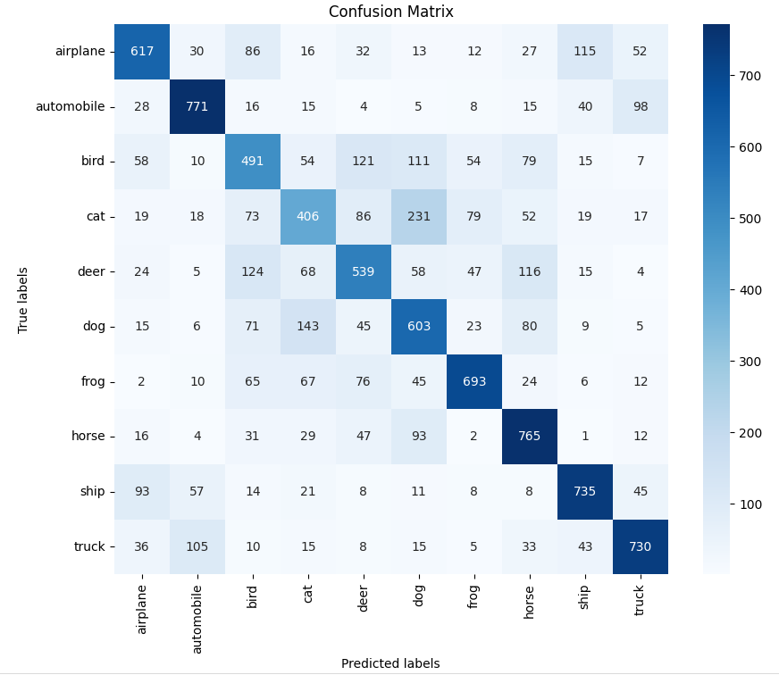
Evaluation Metrics and Results:

Slide 10
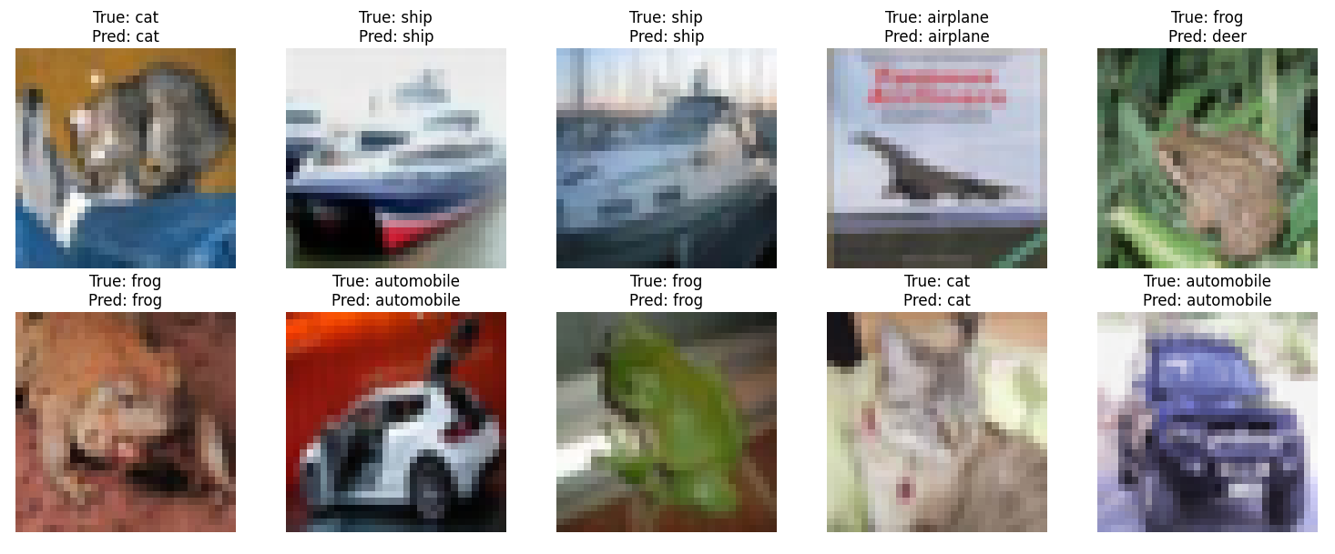
Sample predictions:

Slide 11
Conclusion
This project aims to develop an image classification system using Convolutional Neural Networks (CNNs) on the CIFAR-10 dataset, comprising 60,000 32x32 color images in 10 classes. Pre-processing includes normalization, resizing, and augmentation. Training uses Adam optimizer with cross-entropy loss, focusing on achieving high accuracy. Evaluation metrics include accuracy, precision, recall, F1-score, and a confusion matrix for detailed performance analysis.

Slide 12
Future Scope:
Future developments for this project include exploring advanced CNN architectures, adapting the model for specific domains like medical imaging, integrating it into real-time systems, enhancing data augmentation techniques, optimizing deployment for scalability, and investigating collaborative learning methods for distributed datasets. These efforts aim to enhance the model's accuracy, efficiency, and applicability across diverse real-world applications.

Slide 13
References :
Dataset : https://www.cs.toronto.edu/~kriz/cifar-10-python.tar.gz

Slide 14
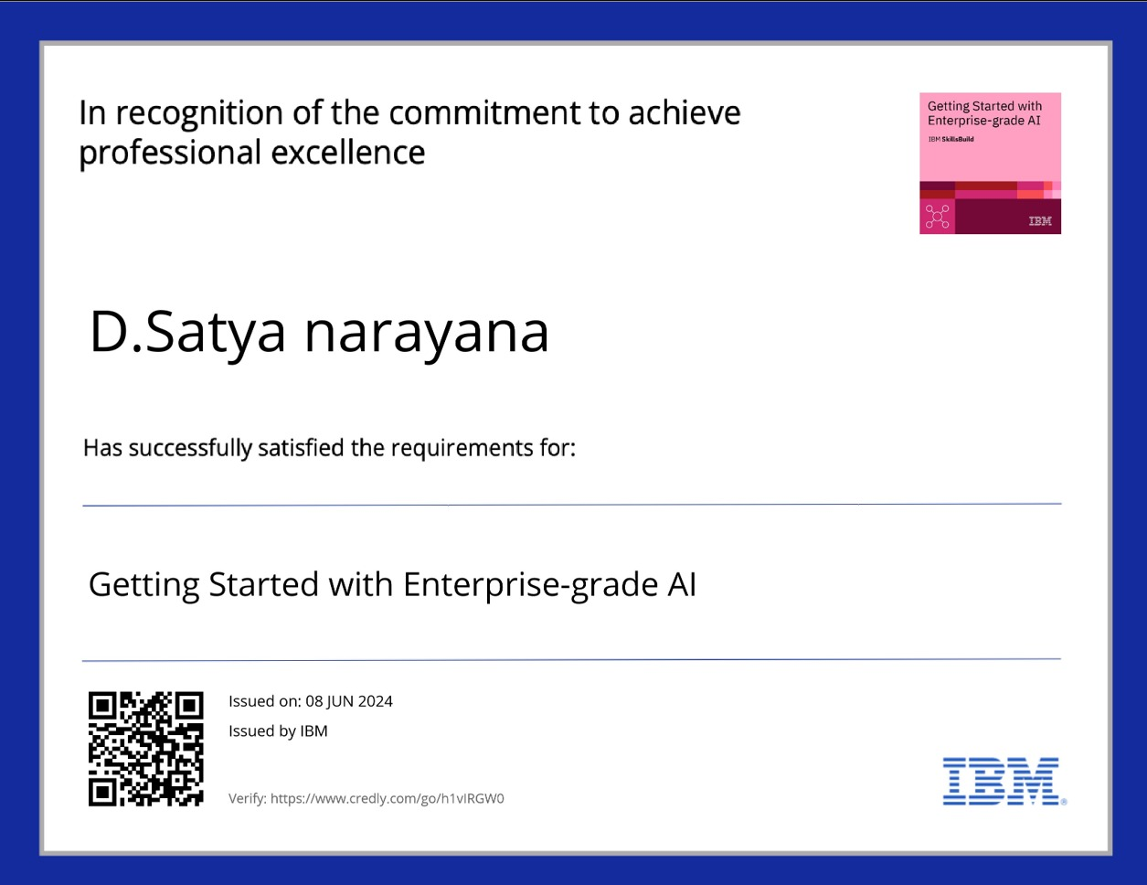
Course Certificate 1

Slide 15
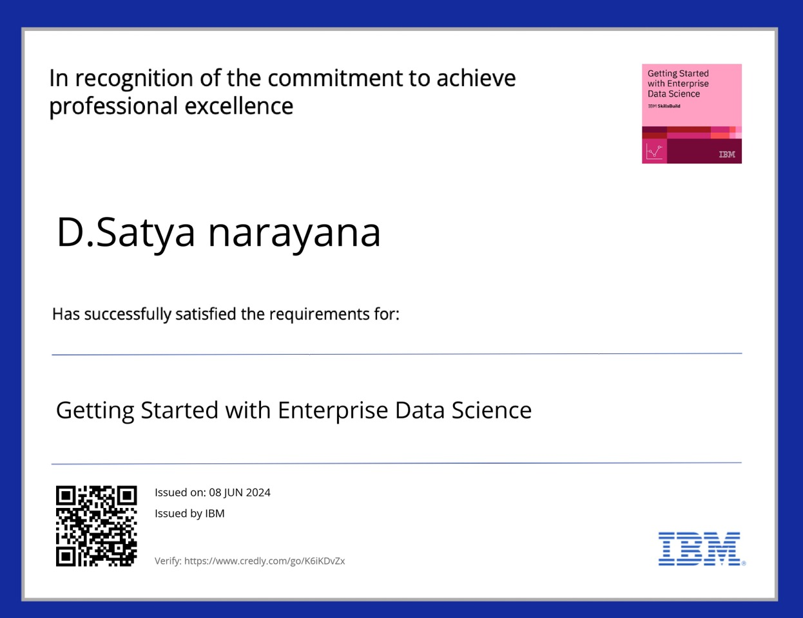
Course Certificate 2

Slide 16
Thank You

